Slide 1
Immunoprofiling 2023
Deciphering Antigen Receptor Biology Through Bioinformatics

Slide 2
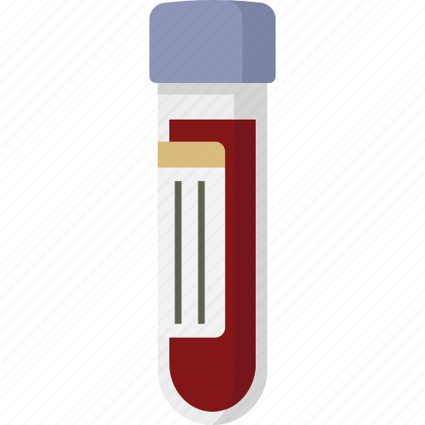
Motivation
What can antibodies and T-cell receptors (collectively, immune receptors) tell us about health?
A milliliter (1ml) of blood:
1 million PBMCs (Peripheral Blood Mononuclear Cells) aka White Blood Cells): lymphocytes [B-cells: 15%, T-Cells: 70%]; monocytes, basophils, eosinophils, neutrophils: 5%; natural killer [NK] cells: 10%)*
3-6 million Red Blood Cells
*Numbers affected by health. Other tissues (lymph, tumors, …) are also analyzed.
References
https://www.ncbi.nlm.nih.gov/books/NBK2263/#:~:text=Red%20blood%20cells%20transport%20oxygen&text=Also%20known%20as%20erythrocytes%2C%20RBCs,through%20the%20smallest%20blood%20vessels.
https://www.ucsfhealth.org/medical-tests/wbc-count#:~:text=Normal%20Results,or%20may%20test%20different%20specimens.
https://www.ncbi.nlm.nih.gov/pmc/articles/PMC4549105/

Slide 3
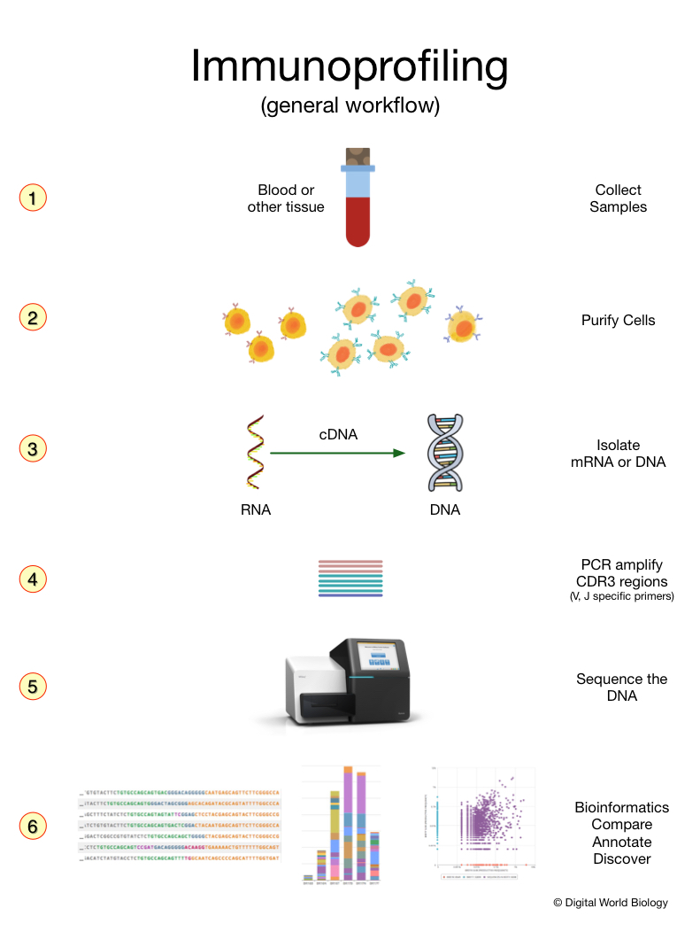
Immunoprofiling - Characterize Immune Receptors
DNA sequencing is used to assess the numbers of different B-Cells and T-Cells to measure:
Active infections, allergies
Cancer treatment, vaccine efficacy
Past disease exposure
Teaches concepts related to immune gene rearrangement (VDJ, VJ) and diversity, and cellular expansion (clonality).
https://digitalworldbiology.com/blog/what-immunoprofiling

Slide 4
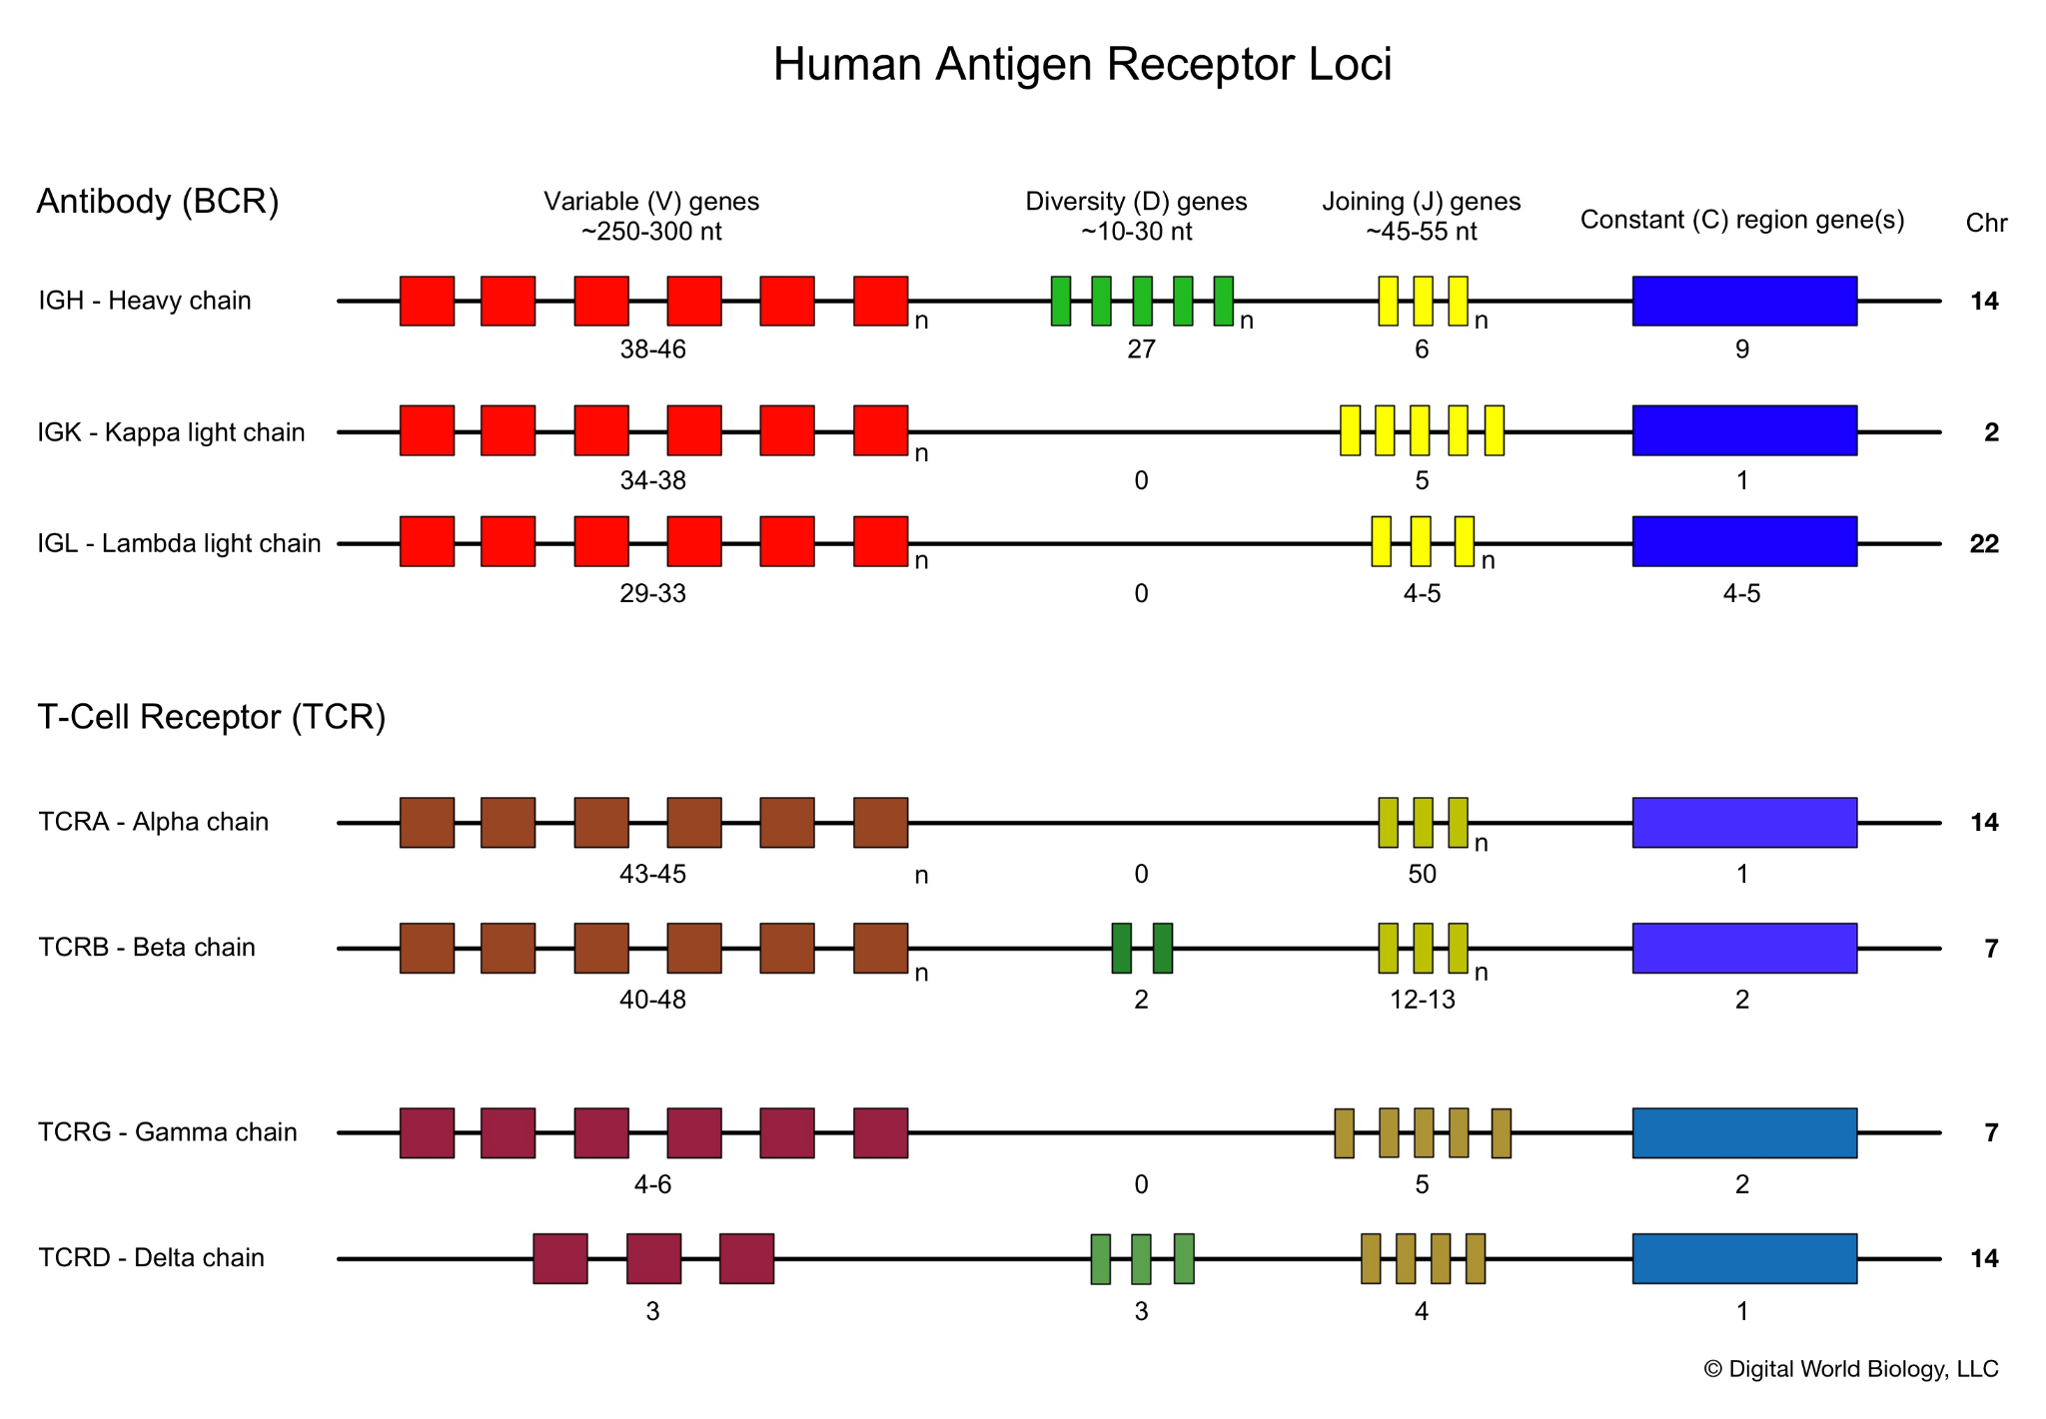
Antibody and T-Cell Receptor Genes and Loci
Pop Quiz
If an antibody has one heavy and one light (kappa or lambda) how many combinations are possible?
TCRs are either alpha/beta or gamma/delta, how many are possible?
How might diversity be increased?

Slide 5
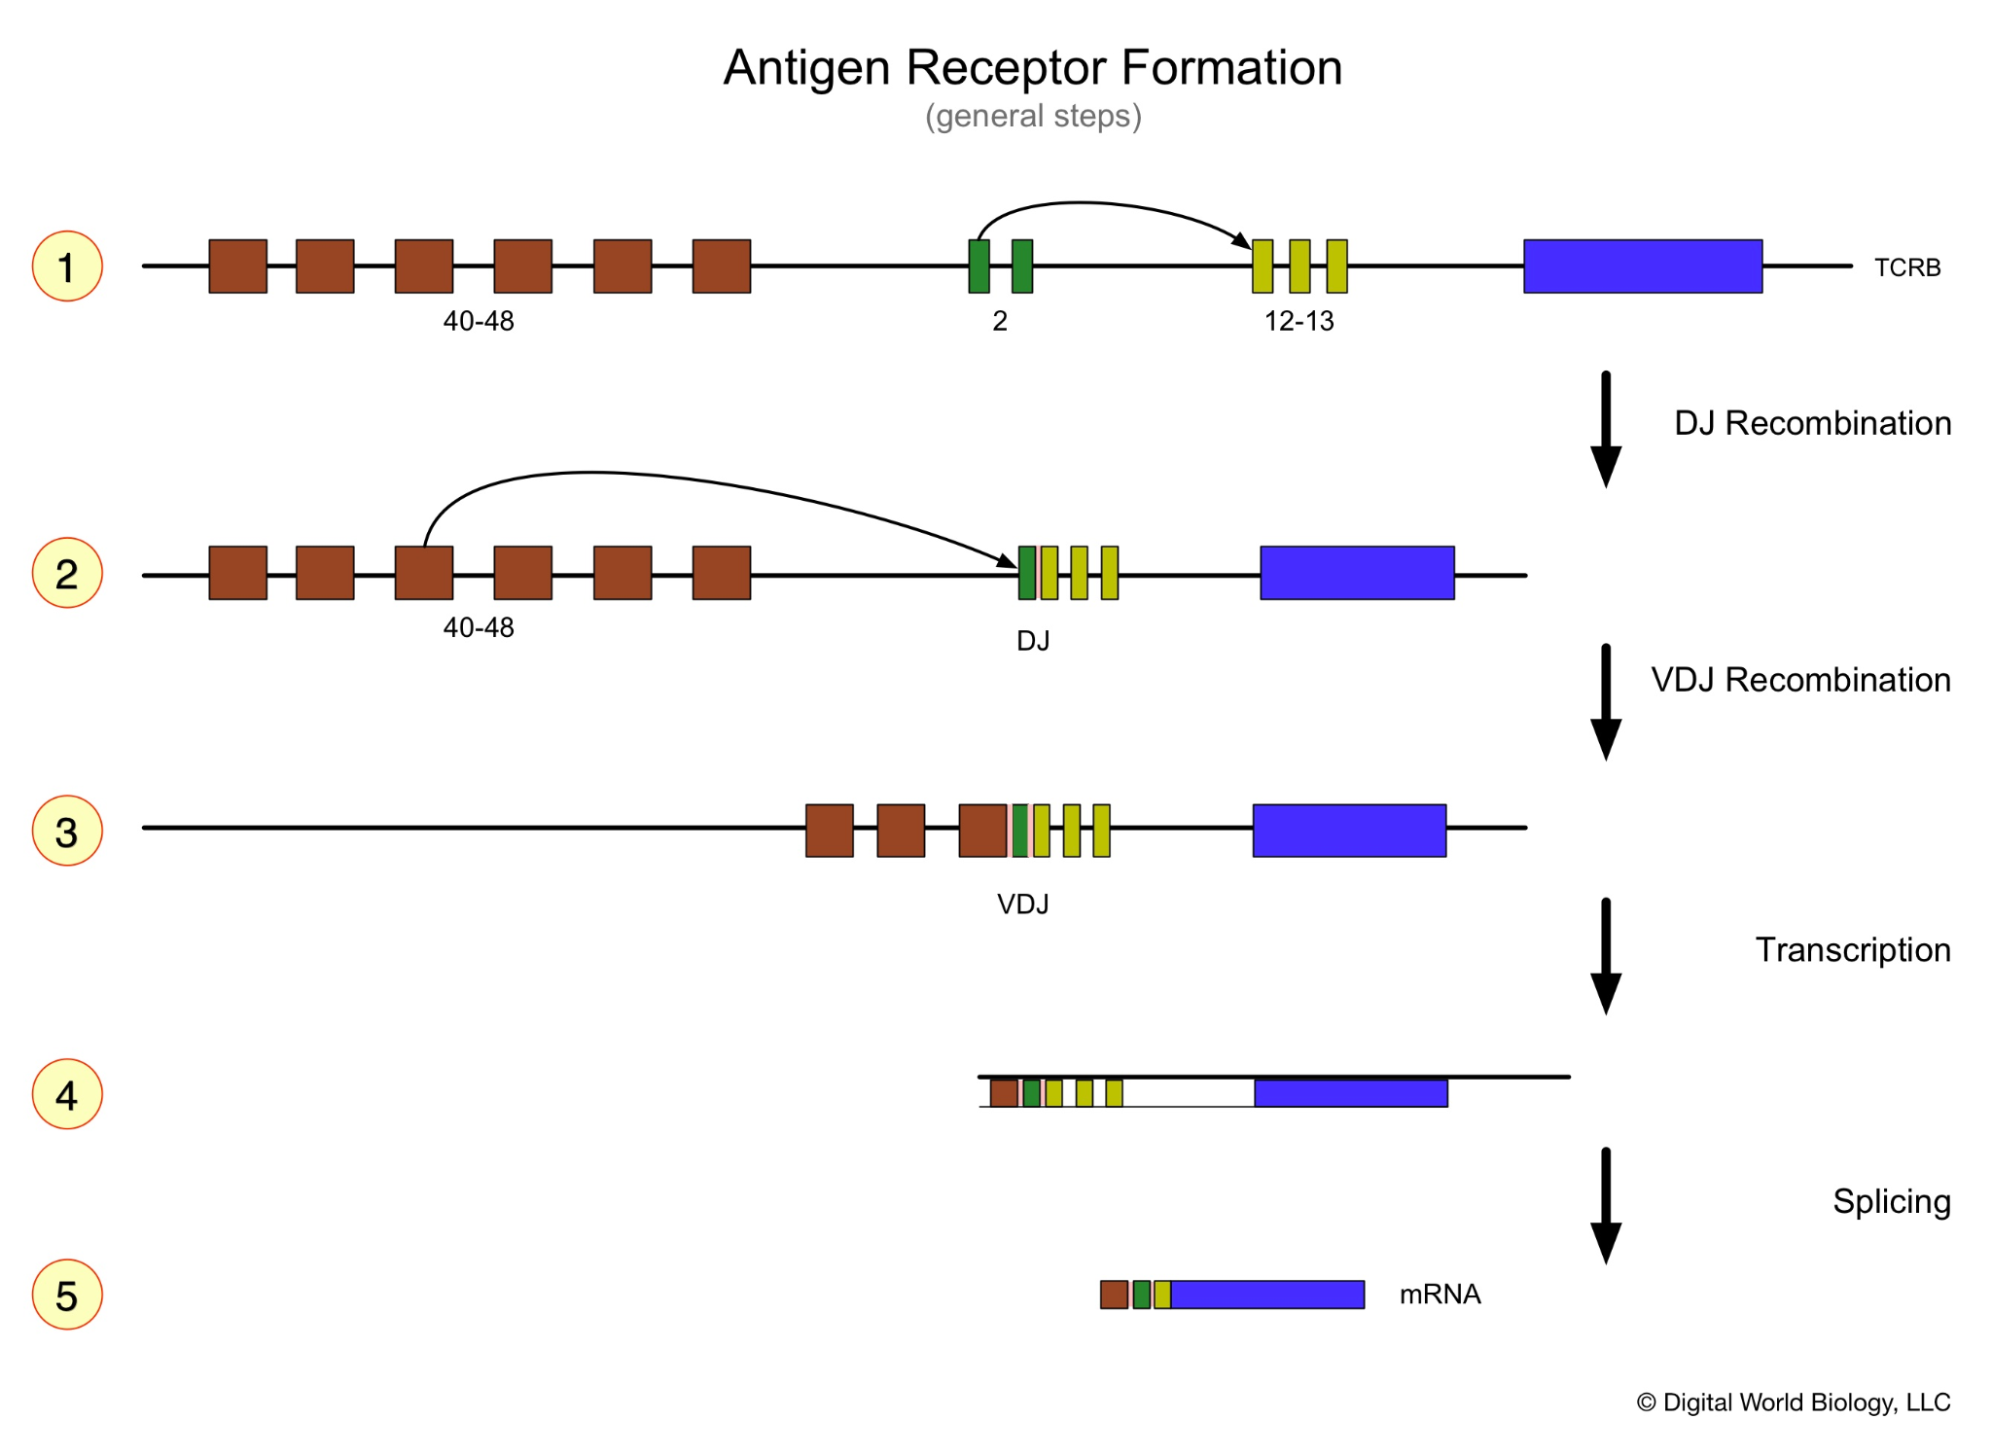
Antigen Receptor Gene Rearrangement Creates Diversity
Pop Quiz
It’s subtle but there are pink regions between the VDJ junction, what might those represent?

Slide 6
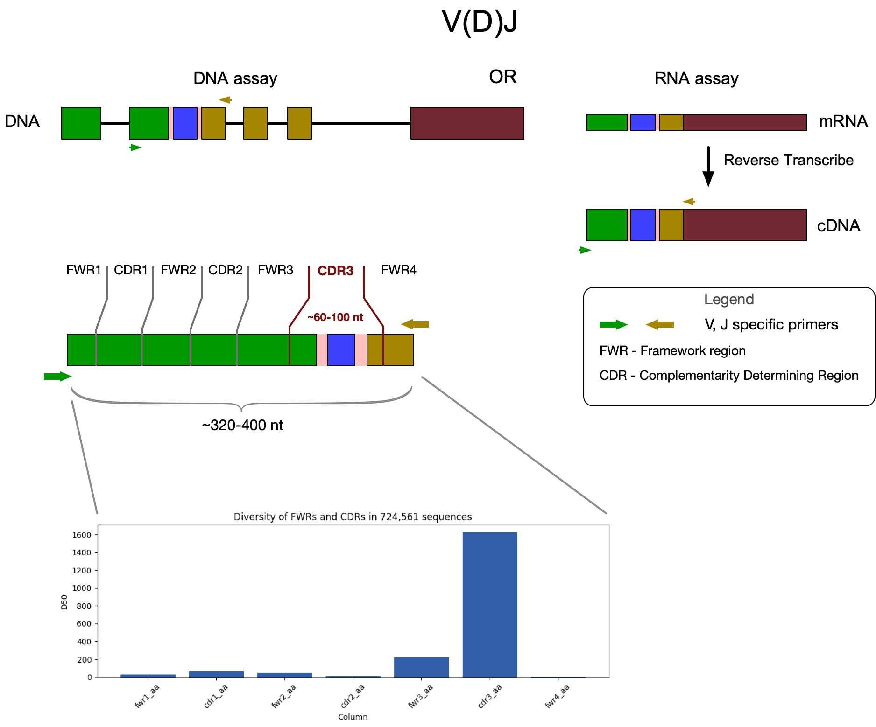
Basic Principal
Pop Quiz
How many primer pairs are need to sample the full diversity?
What could go wrong/bias the data?
Diversity of FWRs and CDRs in 700,000+ sequences

Slide 7
The Project
Team
@Ashly Corona Rodriguez
@Keith Loritz
@Oscar Camargo
@Rashmi Naidu
@Miguel Angel Rizzo Ignacio
@Todd Smith
Mexico, Spain, USA
Use immune profiling datasets to learn:
Programing (Python, Jupyter)
Databases (IEDB, iReceptor, NCBI)
Work with large datasets
Millions of sequences
Gb files
Antigen Receptor (AR) biology
Semi-guided exploration

Slide 8
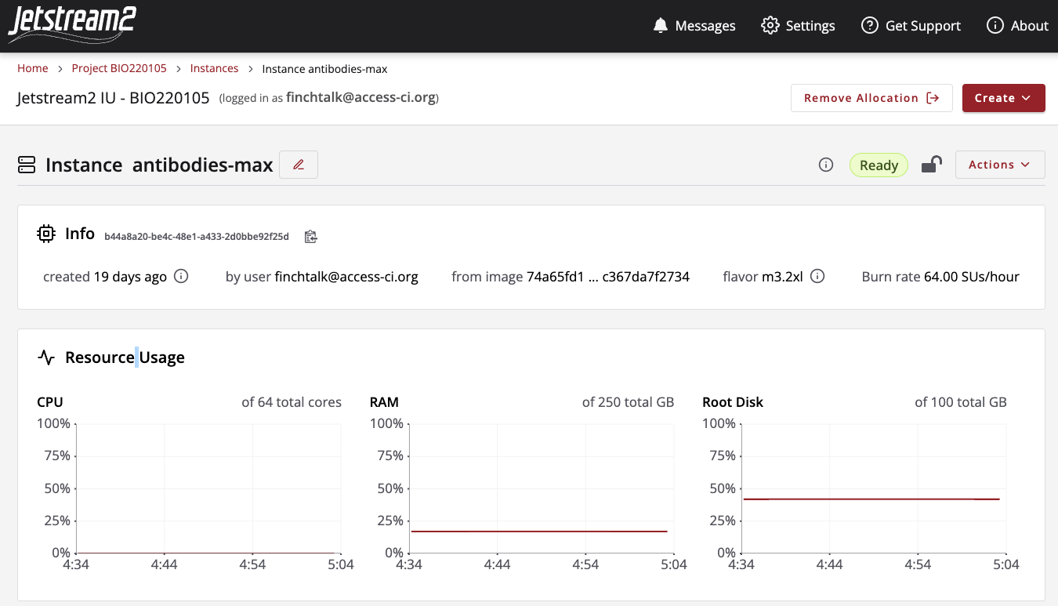


Main Resource
David Y. Hancock, Jeremy Fischer, John Michael Lowe, Winona Snapp-Childs, Marlon Pierce, Suresh Marru, J. Eric Coulter, Matthew Vaughn, Brian Beck, Nirav Merchant, Edwin Skidmore, and Gwen Jacobs. 2021. “Jetstream2: Accelerating cloud computing via Jetstream.” In Practice and Experience in Advanced Research Computing (PEARC ’21). Association for Computing Machinery, New York, NY, USA, Article 11, 1–8. DOI: https://doi.org/10.1145/3437359.3465565

Slide 9
“Measure, then look at the data.”
Engineering: How can we:
Design a process to obtain a desired outcome.
Measure the results.
Improve the process. Improve the measuring.

Slide 10
Topic: Vaccination;
Process to induce an optimal immune response in the host to protect against an environmental or endogenous threat.
Research Project Proposals:
How can we use vaccination to protect against complications from infection/cancer?
How can we measure the effects of vaccination?
How can we improve vaccination? How can we improve measuring?

Slide 11
Undergraduate Research Projects
Utilizing existing tools and data:
How can we measure the effects of vaccination?
Are there any markers of a successful vaccination?
What is the optimal volume of a blood sample needed to determine if a vaccination was successful?
When should blood samples be taken?

Slide 12
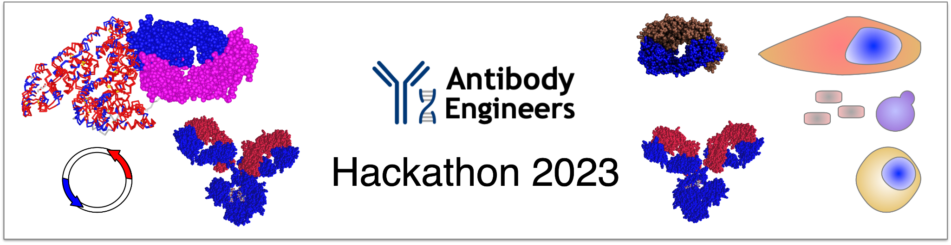
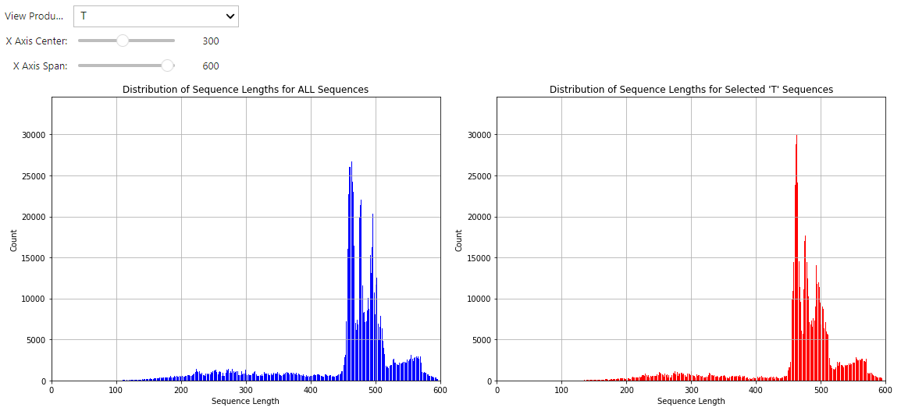
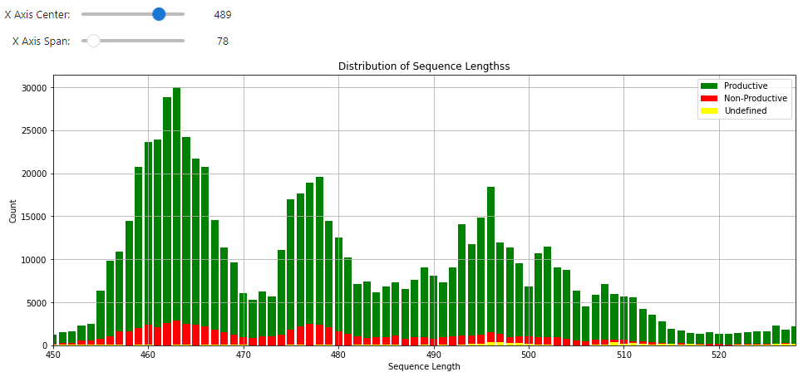
Q: How can we measure the effects of vaccination?
R.P.P.: Immunoprofiling?
Start
Find data
Look at it
Informative
as-is?
Present it
Can it be
processed?
Process it
More
Time?
Done

Slide 13
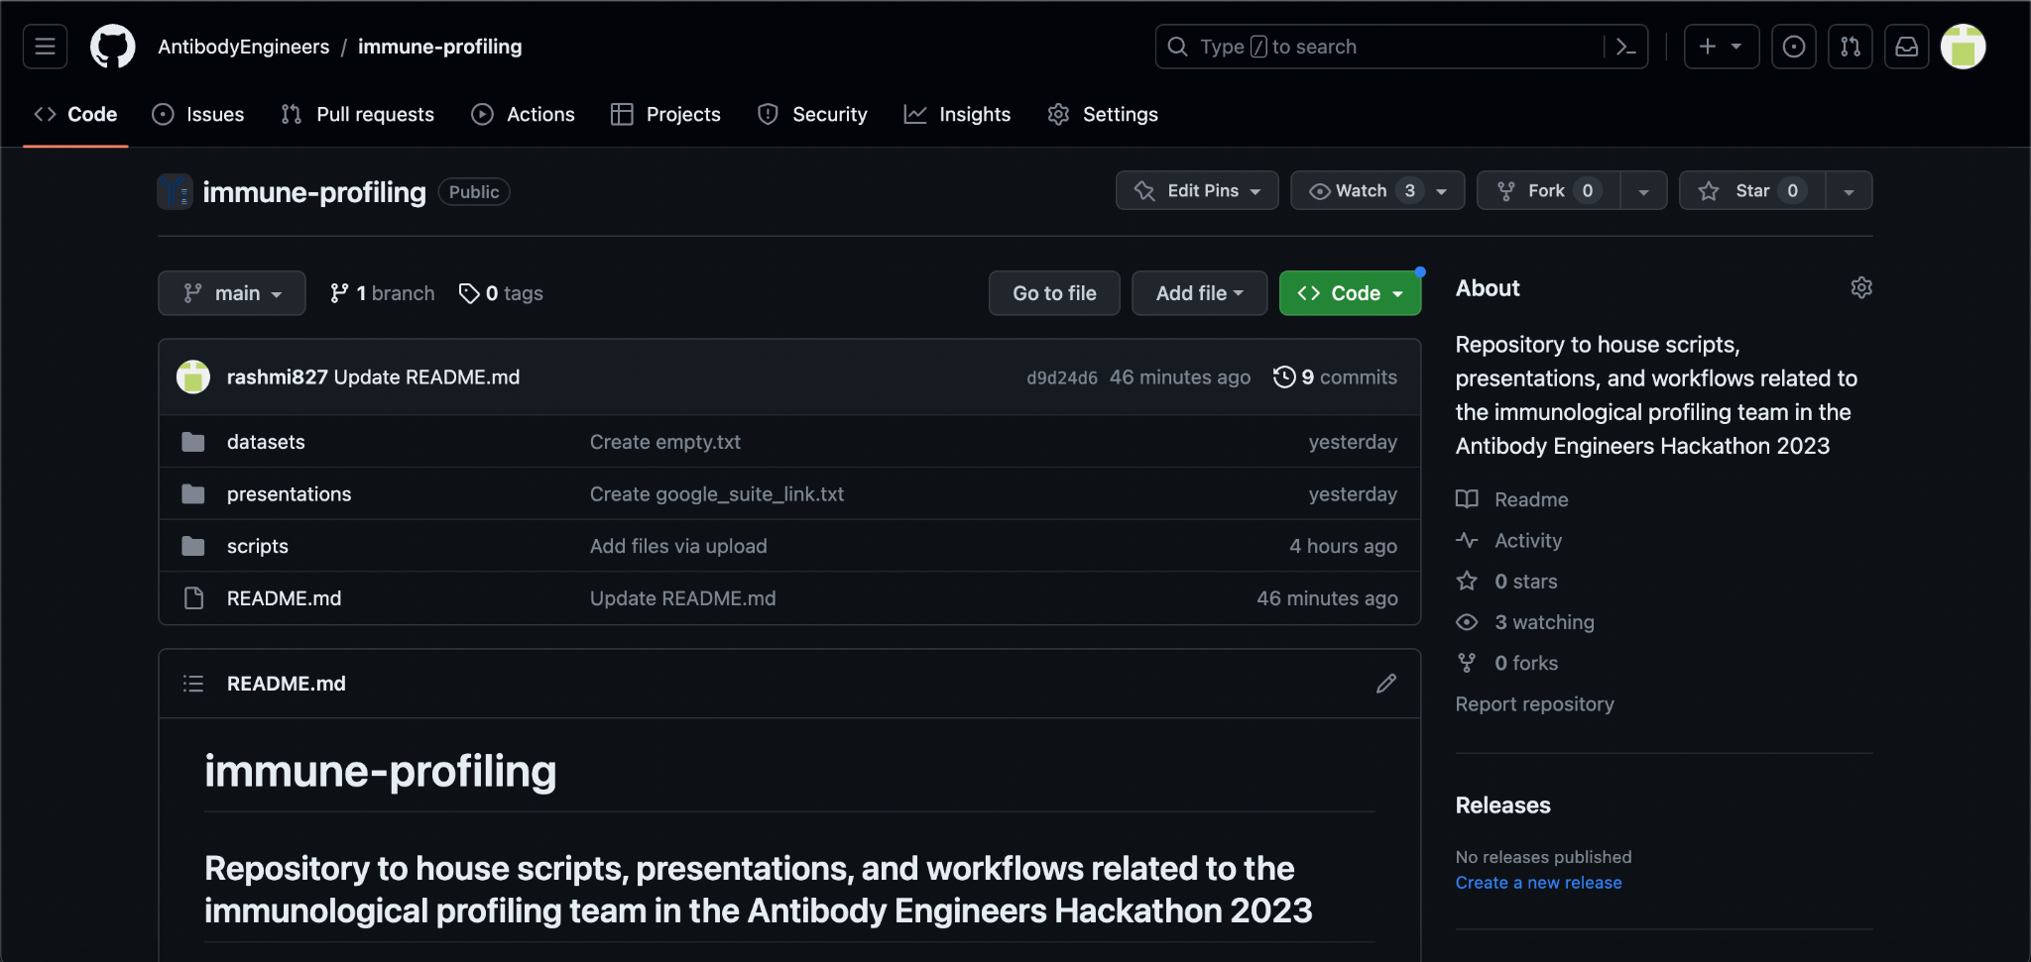
Immune-Profiling Github Page

Slide 14
Parallelization of Transcriptomics Analysis of Immunological Data
INPUT: compressed RNAseq fastq reads
SOURCE: The European Bioinformatics Institute (EBI)
IDENTIFIER: SRR4431764 (NCBI-SRA Run Selector)
QUALITY TRIM: Using Fastp
pandas
CONVERT TO FASTA:
Seqtk
Fastxtoolkit
Bash (using ‘awk’ or ‘paste’
plotly/seaborn
RNASEQ ANALYSIS
INPUT: Igblast TSV
TOOLS
MERGE READS
PROCESS SEQS USING IGBLAST
nextflow/snakemake

Slide 15
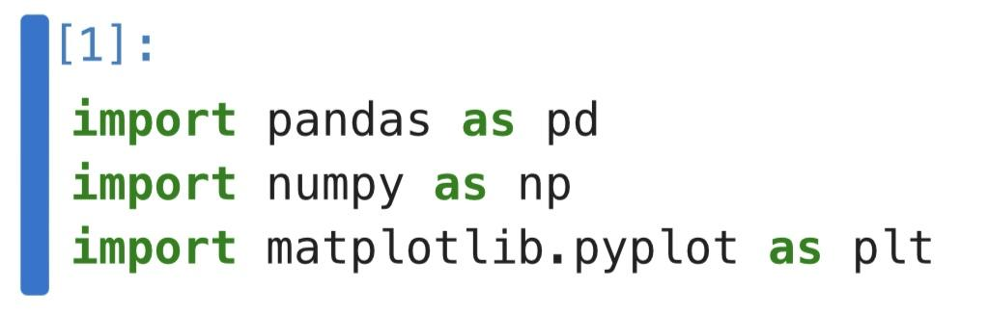
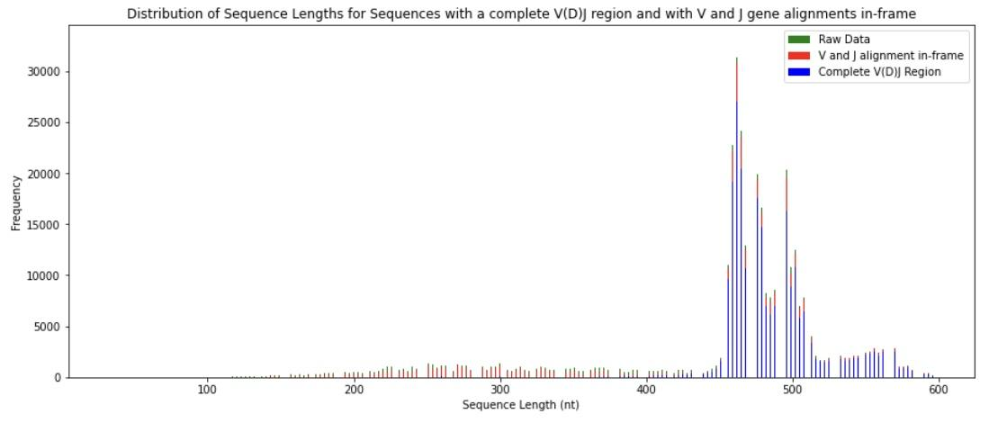
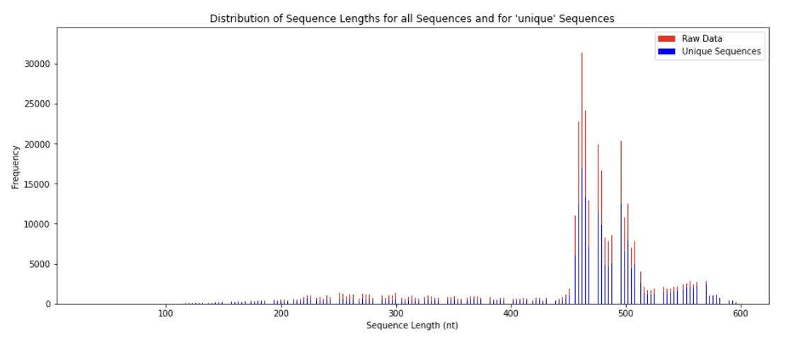
Learning the Bioinformatics tools used in Immune Profiling

Slide 16
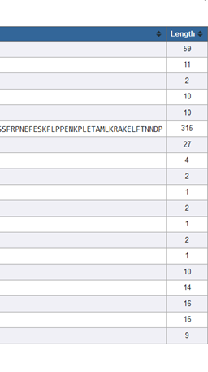
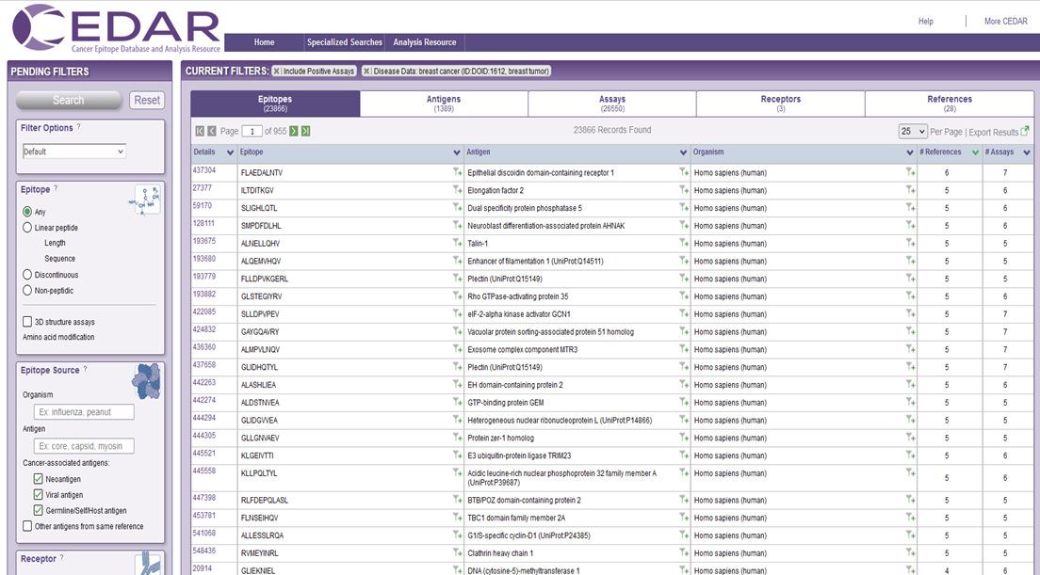
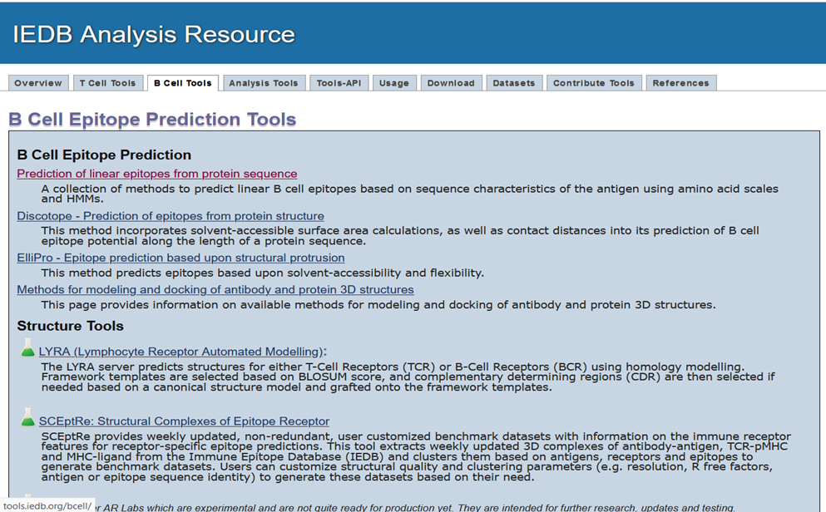
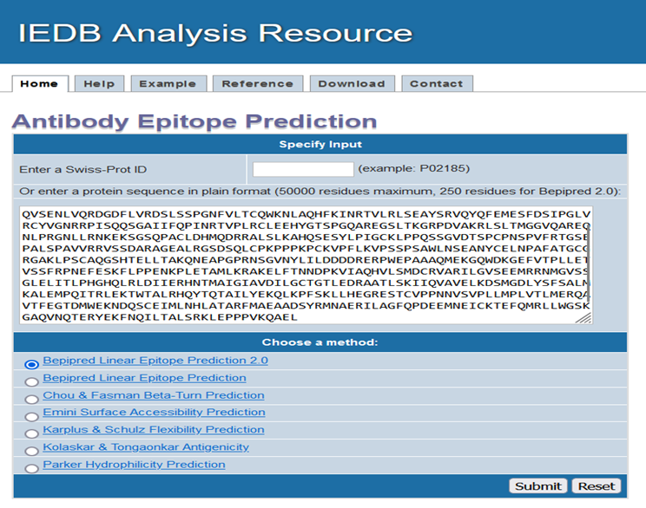
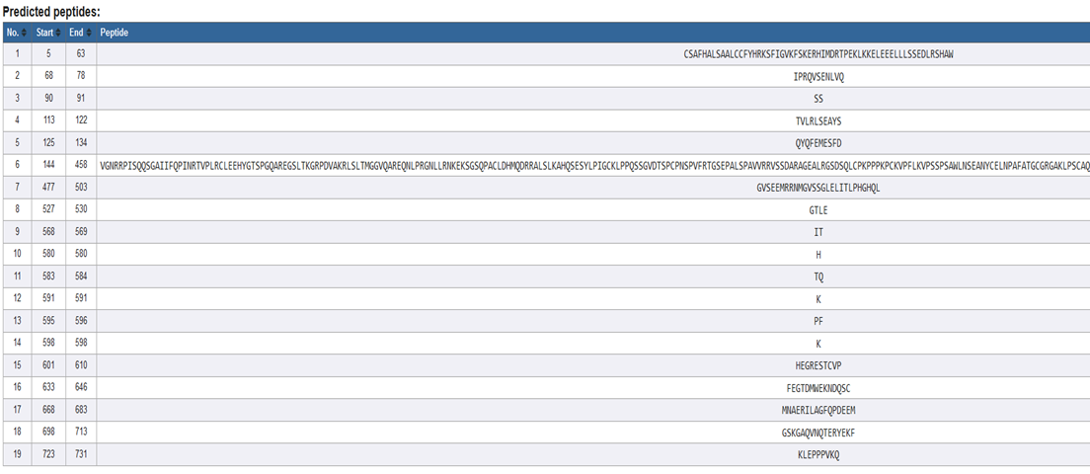
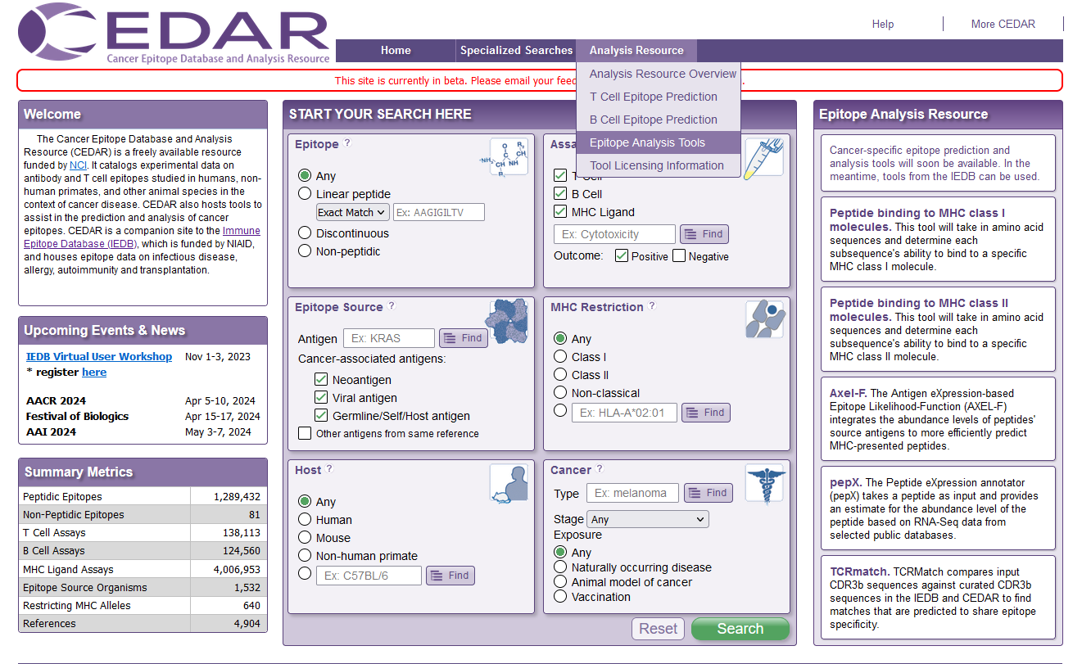
CEDAR

Slide 17
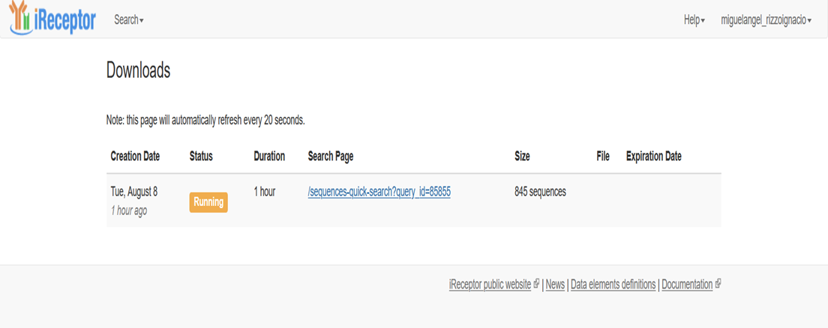
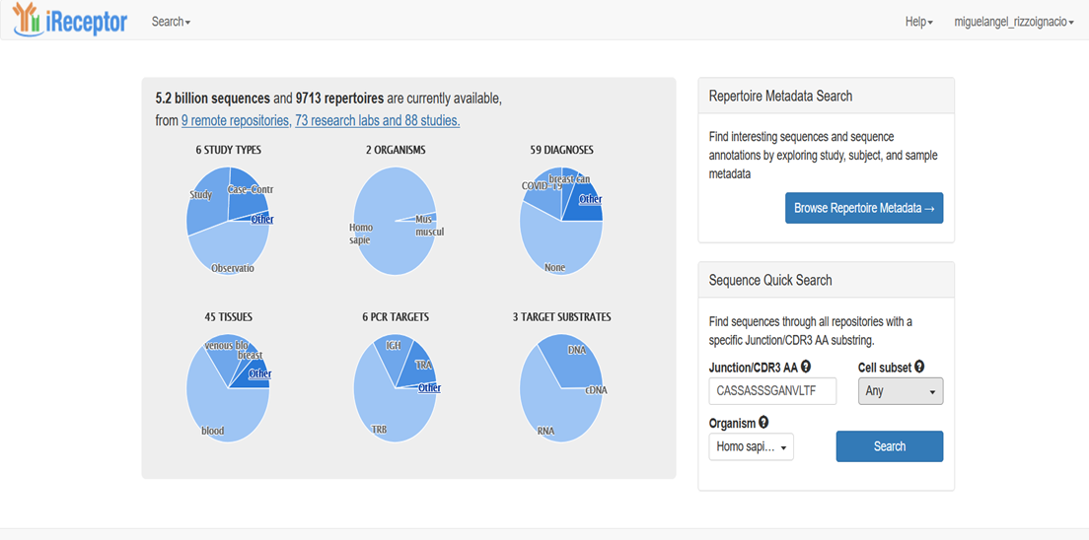
iReceptor

Slide 18
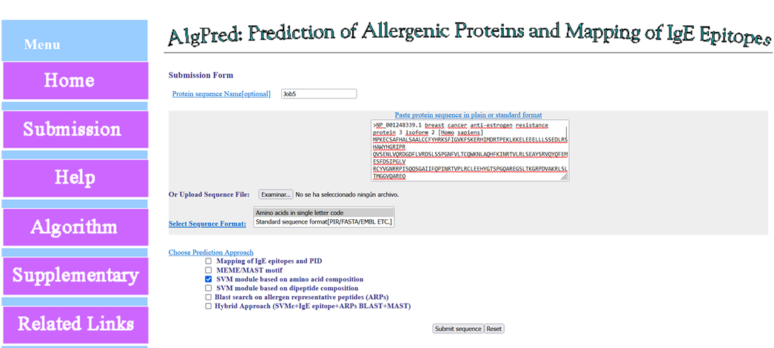
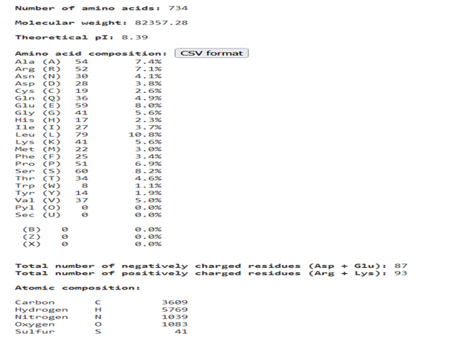
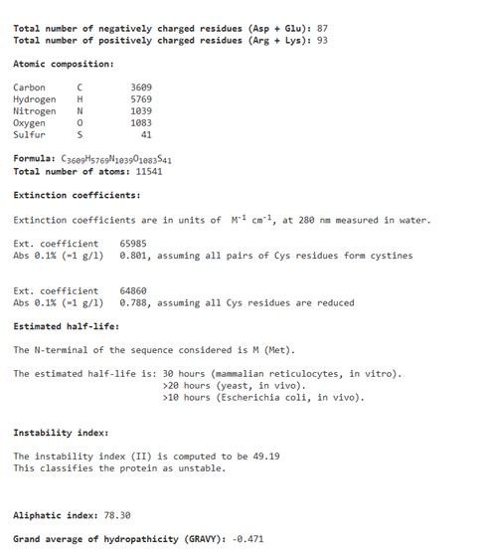
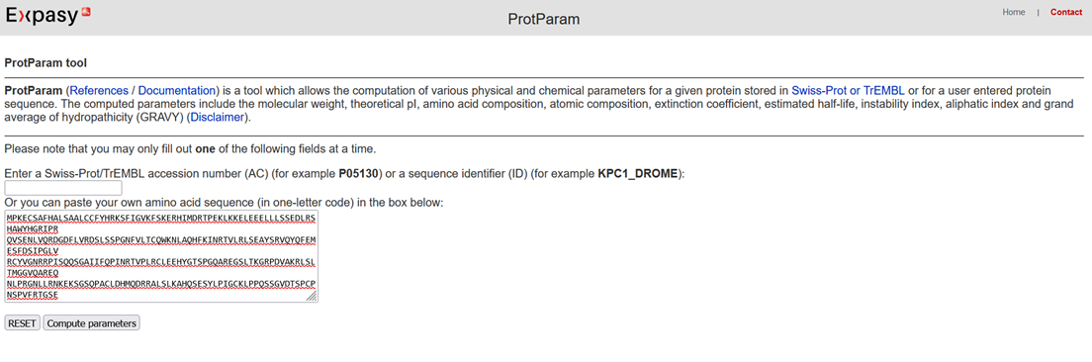
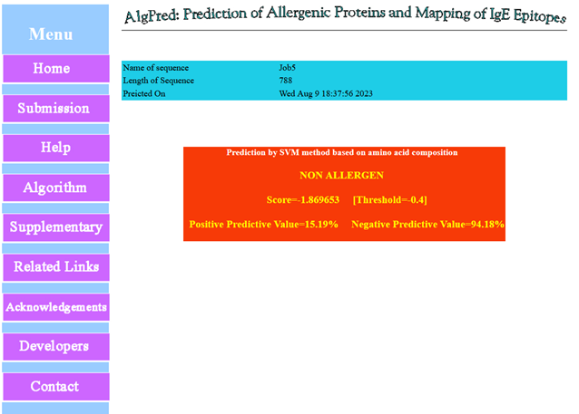
Other tools:
Allergenic protein. https://webs.iiitd.edu.in/raghava/algpred/submission.html
Stability?
https://web.expasy.org/protparam/

Slide 19
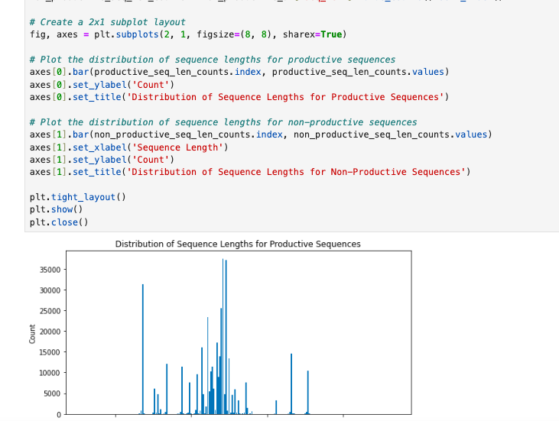
Breast Cancer Data Set
Continue learning codes to get more information from my data set

Slide 20
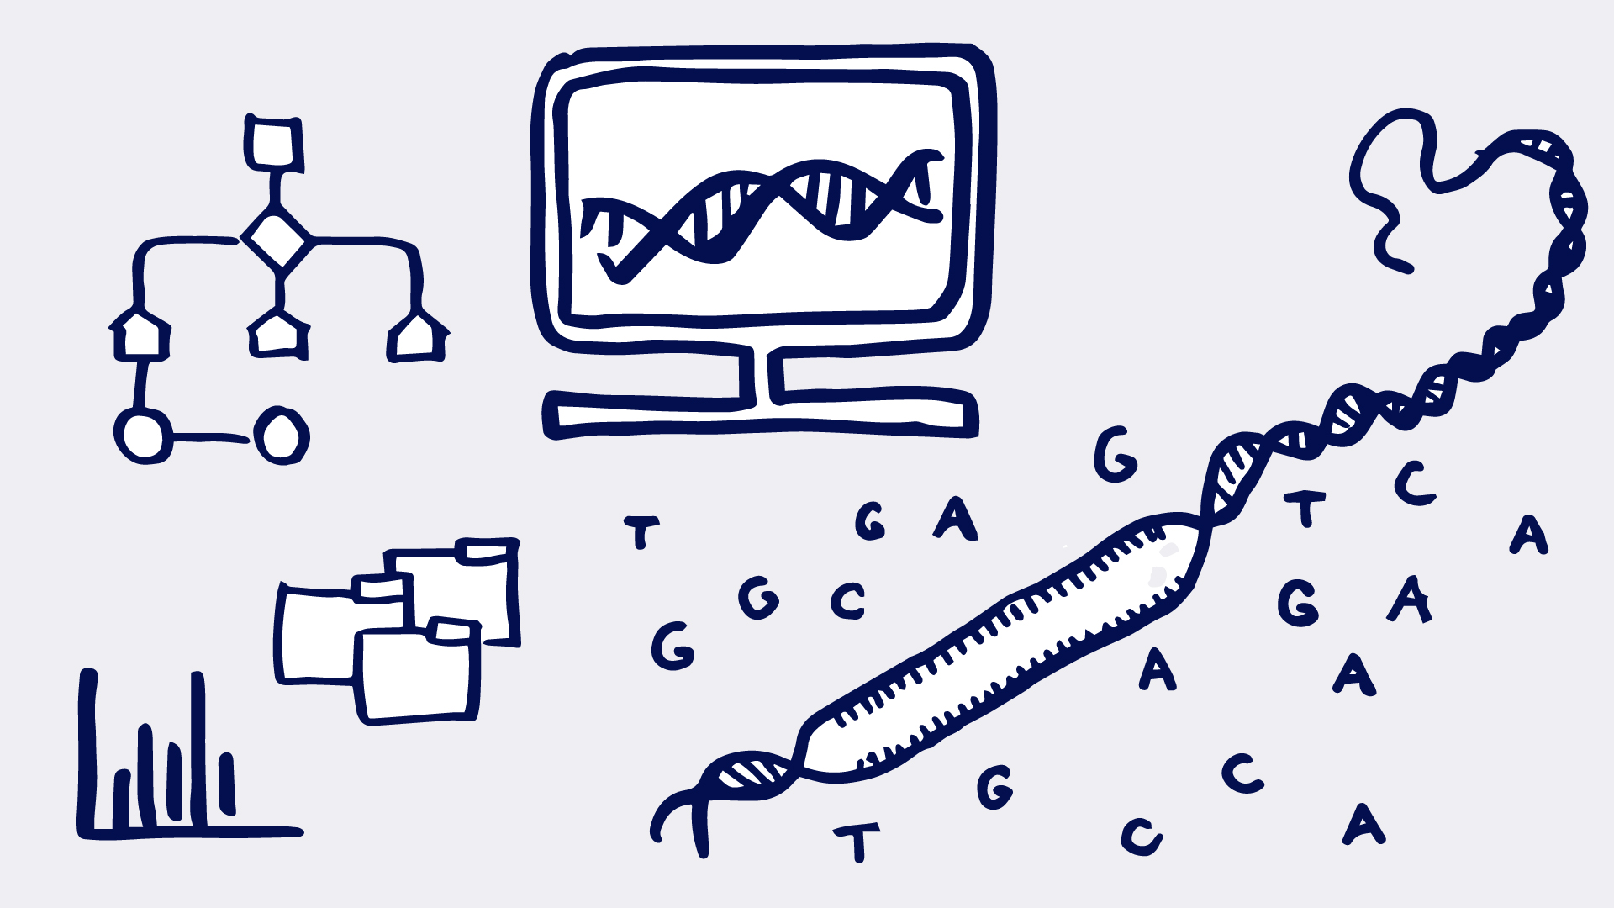
Conclusion
Comprehensive understanding of antibody diversity and structure.
Advance our comprehension of immune responses.

